Slide 1


GPND
Government Polytechnic, Nanded - 431602
Department of Information Technology
TITLE OF THE PROJECT
Blood Donor Receiver App
Group Members : 1) Shivhar Bane – 1547
2) Harsh Zanwar - 1570
Project Guide :- Mr.M.M.Shaikh
Academic Year : 2020-2021

Slide 2
ABSTRACT :
The combination of the smart phone and the Internet service is the trend of the future information development and software applications. Mobile phones are the most commonly used communication tools. Using mobile phones to obtain information is not only quick, but also more convenient shortcut to improve people's lives. In the paper, we propose the software development architecture based on Web services. This framework introduces the three-layer architecture of Web development into mobile phone software development.
Based on the three-layer architecture, the android based Blood Donor Receiver App
is developed. The android based Blood Donor Receiver App can realize to query information for Blood Donors , Blood Notifications . The android based city guide system has more practical significance.
In the current scenario there isn’t any application that would help to a Blood Receiver to get information about the Blood Donor they are currently visiting in their mobile phone.

Slide 3
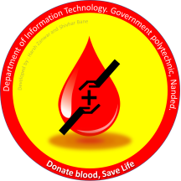
Introduction :
The Android operating system is the largest installed base among various mobile platforms across the globel. Hundreds of millions of mobile devices are powered by Android in more than 190 countries of the world.
We have created this app by looking at someone’s situation. This application is to help people who are suffering with their health and needy for blood.

Slide 4
Literature Review :
BACKGROUND TECHNOLOGIES:
Android :
Developers create apps for a variety of reasons. They may need to address business requirements or build new services or businesses, or they may want to offer games and other types of content for users. Developers choose to develop for Android in order to reach the majority of mobile device users.
JAVA :
Why Use Java?
➢ Java works on different platforms (Windows, Mac, Linux, Raspberry Pi, etc.)
➢ It is one of the most popular programming language in the world
➢ It is easy to learn and simple to use
➢ It is open-source and free
➢ It is secure, fast and powerful
➢ It has a huge community support (tens of millions of developers)
➢ Java is an object oriented language which gives a clear structure to programs and allows code to be reused, lowering development costs

Slide 5
Problem statement for this Android App :
I have created this app by looking at this situation todays situation blood donor can not give blood because lockdown situation. In this Covid-19 situation People Could't Donate their blood at Blood Centers .They have no willing to take risk in such situations and Donate Blood But The problem is the Demand if Blood Transfusion has Increased. Which Cause a lot of Shortage at Blood Camps.
This makes it impossible for the middle and poor to have a blood supply And in such a situation, the signs of death are increasing. And in that case, you don't even get the blood donors of the blood group you need.

Slide 6
Problem Solving :
The concept behind this application is to meet blood donor and blood receiver without any third person . The donor can directly donate the blood to the needy patient.
This way we can fulfill need of the patient and satisfaction
for blood donor.
This platform we help those who are willing to donate The blood and save someone life.

Slide 7
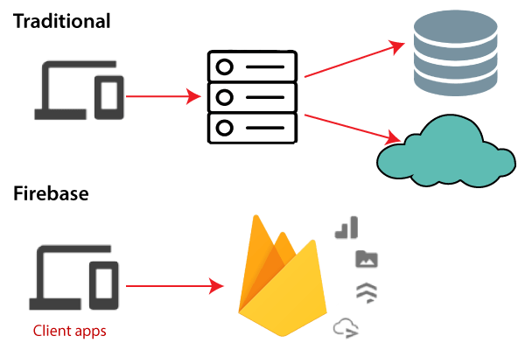
Firebase Database :
In the era of rapid prototyping, we can get bright ideas, but sometimes they are not applicable if they take too much work. Often, the back-end is the limiting factor - many considerations never apply to server-side coding due to lack of knowledge or time.
Firebase is a Backend-as-a-Service(BaaS) which started as a YC11 startup. It grew up into a next-generation app-development platform on Google Cloud Platform. Firebase (a NoSQLjSON database) is a real-time database that allows storing a list of objects in the form of a tree. We can synchronize data between different devices.

Slide 8

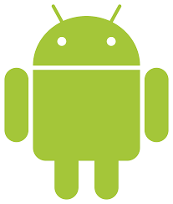
SOFTWARE USED :
Android Studio
JDK ( Java Development Kit )
+

Slide 9
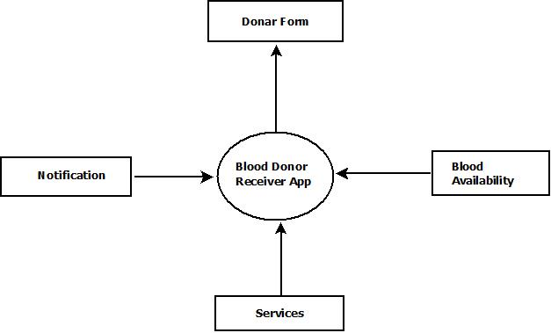
DFD ( DATA FLOW DIAGRAM ) :

Slide 10
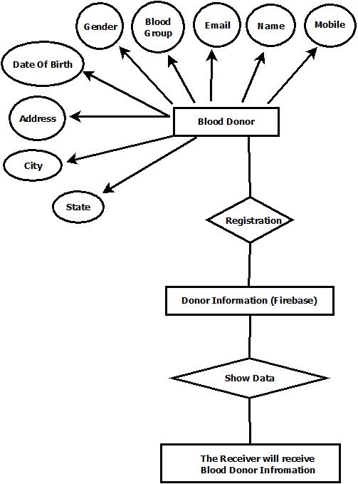
ER DIAGRAM :

Slide 11
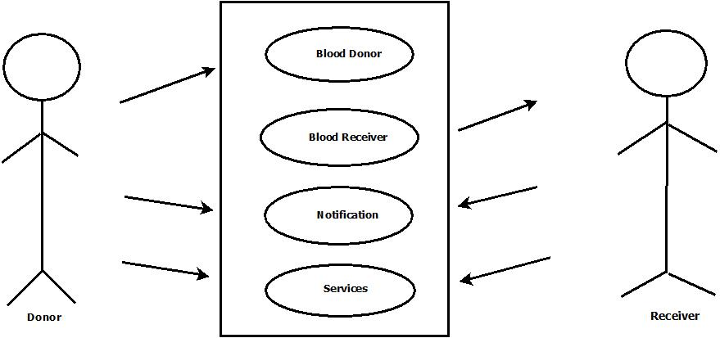
USE CASE DIAGRAM :

Slide 12
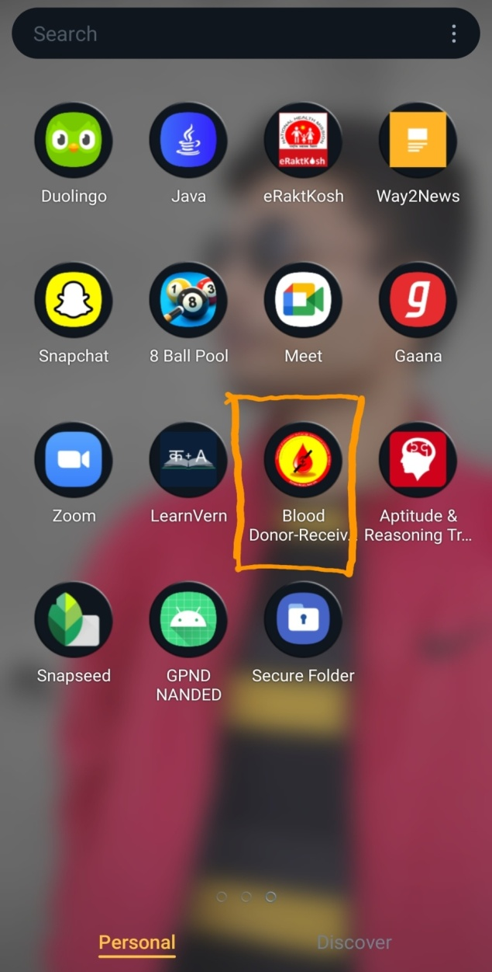
Scope of Project :
This application is to help people who are suffering with their health and needy for blood. Some time the situation of a person who is looking for blood is so critical that he or any of his family member face difficulty to find blood or blood donor. The concept behind this application is to meet blood donor and blood receiver without any third person . The donor can directly donate the blood to the needy patient. This way we can fulfill need of the patient and satisfaction for blood donor.
This platform we help those who are willing to donate The blood and save someone life.

Slide 13
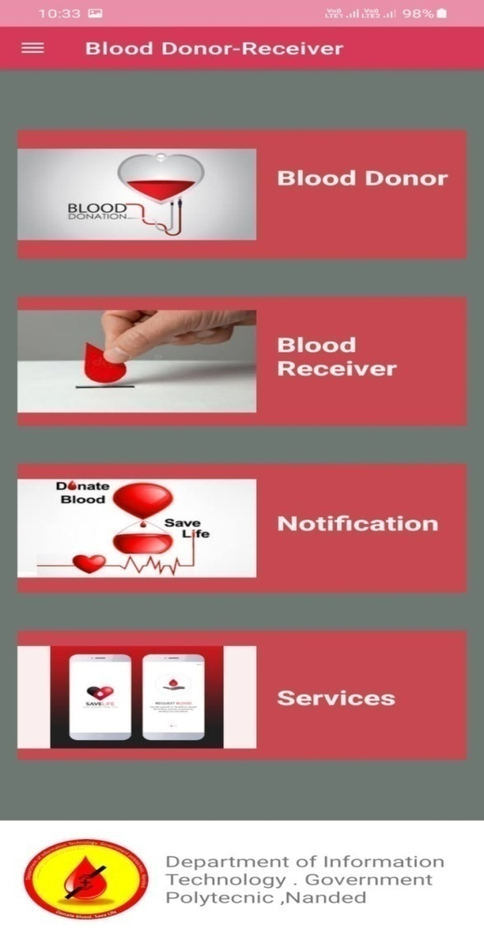
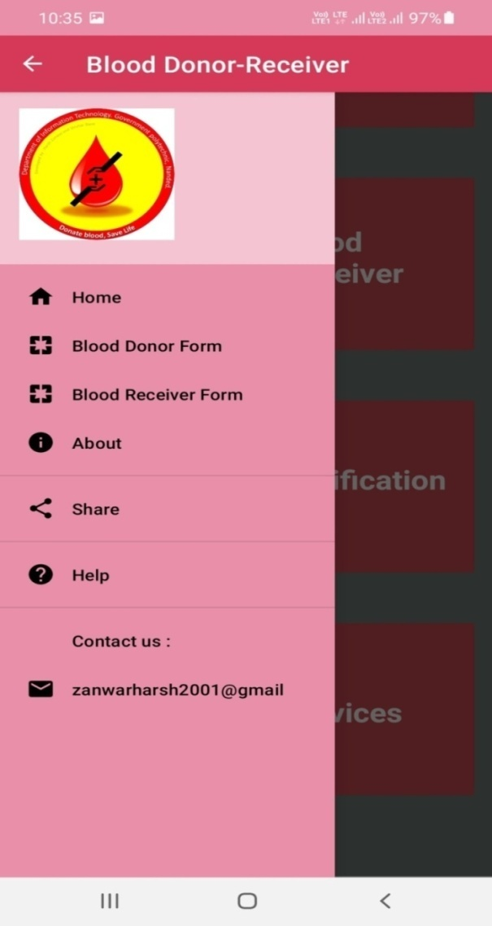
Home Page and Menu Page :

Slide 14
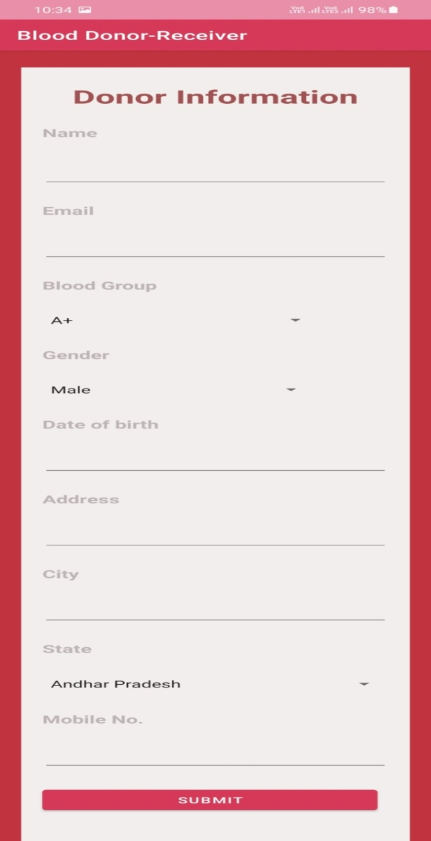
Blood Donor Form :

Slide 15
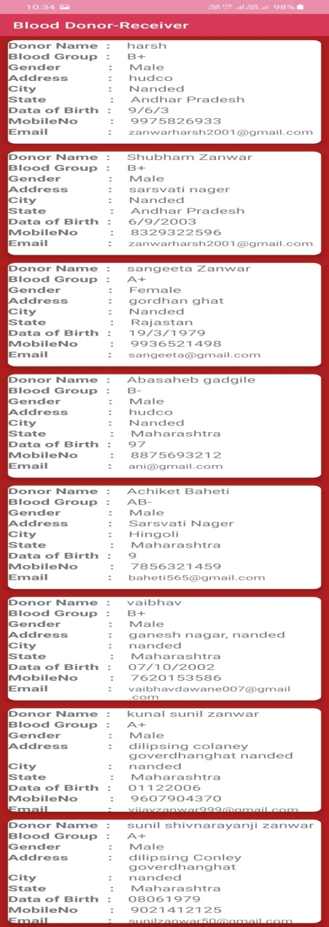
Blood Receiver ( List Blood Donor )

Slide 16
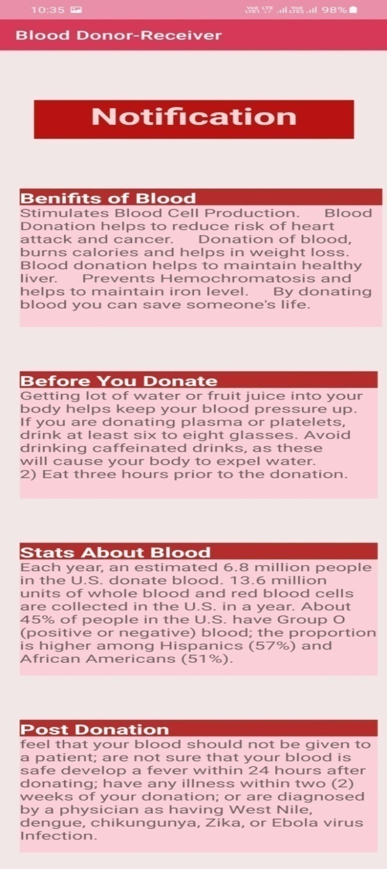
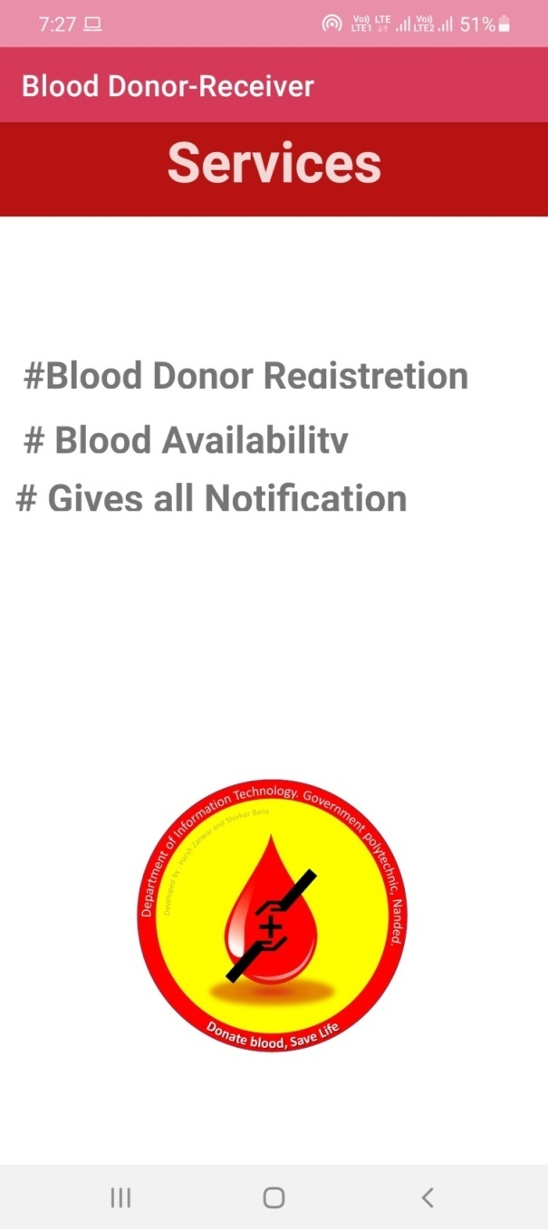
Notification and Services Page :

Slide 17
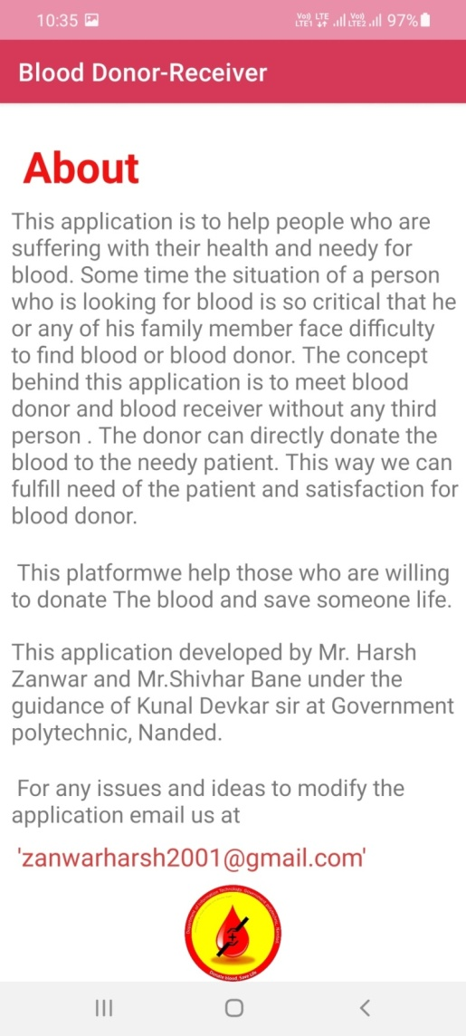
About Page :

Slide 18
Future Scoope :
With this app, we will distribute special prizes to those who have donated blood. We will organize various events. Suppose a person wants blood, he can get it easily by filling in the information with the help of that app. If he wants blood, we will go ahead and offer it. The blood supply service can be faster than other blood banks so that a person can get blood in time. This app will be available to people easily by changing it day by day

Slide 19
Conclusion :
We have learned through this project that the mobile application development is rapidly growing and interesting field and we have chances to make carrier in this field. Within preparing this app we learned many concepts of app development but its just a little knowledge about it. Mobile application development have wide scope in whole world.
Mobile applications are easy to maintain than any software for any type of information. We can easily access it. This is emerging technology.

Slide 20
BIBLIOGRAPHY :
Book References:
1.Android Programming for Beginners
2.Complete reference of Android
Web References:
http://www.google.com
http://www.abhiandroid.com
http://WWW.javatpoint.com

Slide 21
Thank You

